Slide 1
STRUCTURED LITERACY
Introduction

Slide 2
New Zealand has an entrenched literacy problem. And it is the way we are teaching that is the main issue.
Lifting Literacy Aotearoa

Slide 3
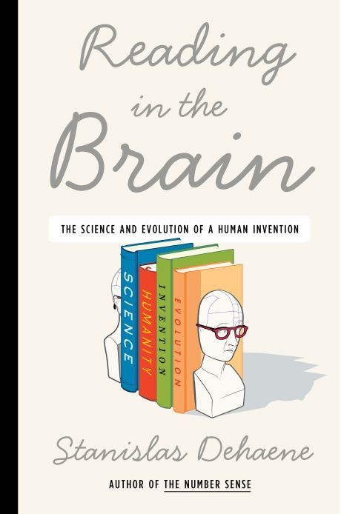
The Neuroscience
How the brain learns to read
Reading is not ‘natural’. We are not born to read. It's an invention. In adults, reading is automatised. We no longer realise how difficult it is. We have an illusion of whole-word reading.
Dr Stanislas Dehaene, Neuroscientist

Slide 4
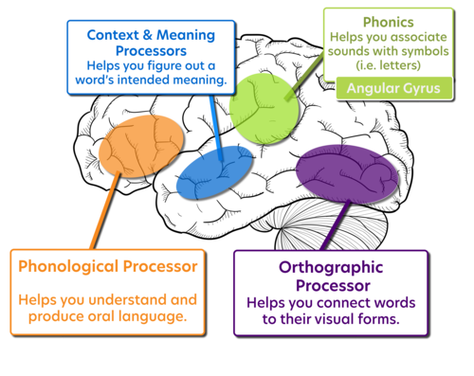
The Reading Mechanism
Is the same for all
Time was simply too short for evolution to design specialized reading circuits.
Learning to read may depend on a process of "neuronal recycling" that causes brain circuits originally evolved for object recognition to become tuned to recognize frequent letters, pairs of letters and words.
References:
https://www.cell.com/action/showPdf?pii=S0896-6273%2807%2900759-3
https://www.youtube.com/watch?v=25GI3-kiLdo
https://literacysanantonio.com/about-the-science-of-reading
Dr Stanislas Dehaene, Neuroscientist

Slide 5
The Science of Reading
Definition
The body of work referred to as the “science of reading” is not an ideology, a philosophy, a political agenda, a one-size-fits-all approach, a program of instruction, nor a specific component of instruction.
It is the emerging consensus from many related disciplines, based on literally thousands of studies, supported by hundreds of millions of research dollars, conducted across the world in many languages.
These studies have revealed a great deal about how we learn to read, what goes wrong when students don’t learn, and what kind of instruction is most likely to work the best for the most students.
References:
https://www.aft.org/sites/default/files/moats.pdf
https://www.whatisthescienceofreading.org/
— Louisa Moats

Slide 6
Structured Literacy
Approach aligned to the Science
How do children learn to read?...The answer is the same for all children. Cultural, economic, and educational circumstances obviously affect children’s progress, but what they need to learn does not change.
References:
https://www.zaner-bloser.com/reading/superkids-reading-program/pdfs/Whitepaper_TheScienceofReading.pdf
—Seidenberg, 2017, p. 101

Slide 7
Why Structured Literacy?
Backed by 1,000s of studies
Most recent NZ study commissioned by MoE in 2018: Massey University Early Literacy Project. Also see US National Reading Panel findings
Is the most equitable approach….works for ALL children
Is incredibly empowering for teachers

Slide 8
What is Structured Literacy?
These key evidence-based
principles of instruction are essential
Explicit instruction begins with direct instruction and includes guided practice with decreasing levels of support. The objective of the lesson is clear and teaching is intentional.
Systematic instruction provides a definite scope and sequence of skills from less complex to more complex and includes cumulative review.
Instruction is data-driven and focused on essential skills. All students receive high-quality, evidence-aligned tier one instruction. Students at risk are identified
early on and are provided with specific, targeted instruction; progress is monitored and adjusted continually.
Engaging instruction clarifies the purpose for the learning tasks, provides opportunities for incremental steps of success, reflects students own realities.
Explicit
Systematic
Diagnostic
Engaging

Slide 9
What is Structured Literacy?
These elements need to be taught
In the Report of the National Reading Panel (NICHD, 2000), the panel identified the five components of reading that are essential and effective when taught thoroughly and skillfully. These findings were based on reviewing over 100,000 studies on reading.
See also: https://www.whatisthescienceofreading.org/science-of-reading-guide

Slide 10
What is Structured Literacy?
Three organising principles for ensuring success
Earlier rather than later: Prevention and early intervention are supremely more effective and efficient than later intervention and remediation for ensuring reading success.
Schools, not just programs: Prevention and early intervention must be anchored to the school as the host environment and the primary context for improving student reading performance.
Evidence, not opinion: Prevention and early intervention pedagogy, programs, and procedures should be based on trustworthy scientific evidence.

Slide 11
What is Structured Literacy?
Scientific Learning Principles
Must attend closely to features of sensory task.
To maintain attention, must be able to perform task at a high level of accuracy (if the task is too difficult, learning cannot be achieved and changes in sensory map do not occur).
Behaviour must be reinforced in a highly consistent and rewarding manner to maintain motivation and drive learning through corrective feedback.
Highly consistent, repetitive input must be given over an intense period of time so that consistent patterns of neuronal activation occur repetitively, building specific stimulation patterns to "represent" the input from the environment in the brain.
Once a behavior is established (i.e, the response is accurate and consistent), learning can be driven most effectively by systematically increasing the difficulty of the task as performance improves.
Tallal, Merzenich, Jenkins, & Miller, 1999.

Slide 12
So what is different?
Structured Literacy
Reading, spelling, handwriting and phonics are taught at the same time during the literacy session
Instruction is explicit, sequential and cumulative with lots of time for repetition and mastery
Students are using decodable (controlled) texts
Students are beginning to use vocabulary related to structured literacy e.g. vowels, digraphs, floss rule etc.
We are expecting more students to reach the required curriculum level
Whole Language/Balanced Literacy
Reading, spelling, handwriting, and phonics all taught separately
Is not explicit or sequential or cumulative
Students read predictive texts (reading books)
Students do not have or use vocabulary related to structure of the language
Significant number of students below required curriculum level

Slide 13
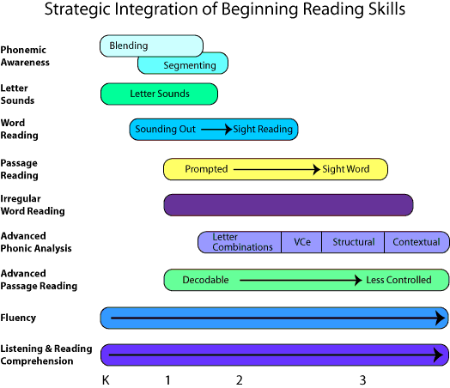
Staging and Integrating
http://reading.uoregon.edu/cia/instruction/index.php

Slide 14
Skills and Knowledge to be learnt
Knowledge for Teachers
Simple View of Reading
Science of Reading
Alphabetic Principle
Skills for Teachers
Application of the research - Structured Literacy Principles: Explicit; Diagnostic; Systematic/Cumulative
Knowledge for Learners
Phonological Awareness
Phonemic Proficiency
Vocabulary
Skills for Learners
Application of knowledge to
Blend
Segment
Master Phoneme manipulation

Slide 15
What is Structured Literacy?
Tips for teachers
Identify early and intervene strategically.
Focus on the vital signs.
Teach "less" more thoroughly.
Instruction before construction.
Hold instructional time sacred.
Expect and plan for "different" levels of instruction (e.g., small groups, double dose).
Monitor progress to determine if children are learning enough

Slide 16
Still include creative writing, shared books, read-alouds, poetry and opportunities to respond to text in our literacy programme.
Still have high expectations for our students.
Still be doing assessments and reporting to you on where you child is at in relation to the NZ Curriculum levels.
What’s the same

Slide 17
Structured Literacy
Decodable Readers
Decodable Readers
Based on the scientific sequence of how the brain learns to read.

Slide 18
More information
Video Clips
http://reading.uoregon.edu/resources/video_list.php
https://www.readingrockets.org/podcasts
Podcasts
https://www.apmreports.org/episode/2019/10/23/hanfordandreading
Websites
https://www.liftingliteracyaotearoa.org.nz/support/websites
https://www.whatisthescienceofreading.org/science-of-reading-guide

Slide 19
Thanks!!
Mākara Model School Staff

